Slide 1
FAPA Chapter Open House
Meeting
July 15, 2018
Auction

Slide 2
FAPA Jackets
Stylishly designed FAPA jacket.
No longer available from FAPA HQ.

Slide 3
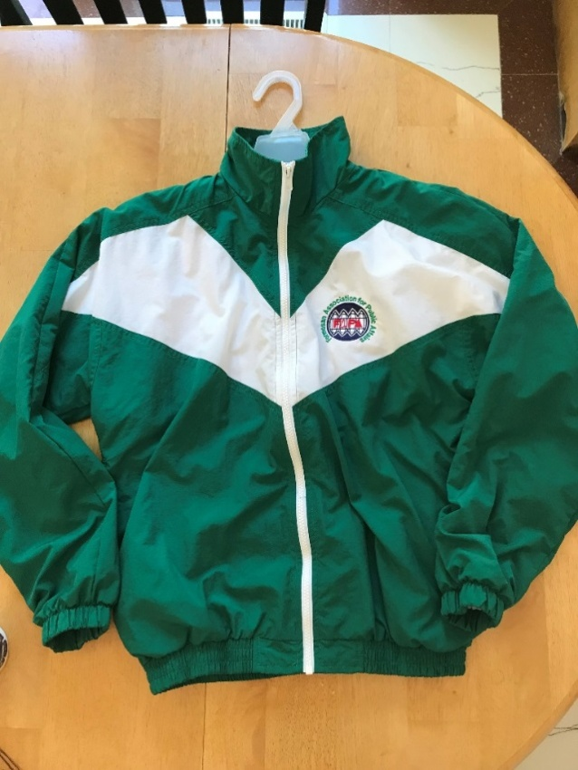
Size M 2 EA Size L 2 EA

Slide 4
Contributor:
Su-Mei Kao
James & Amanda Wang

Slide 5
Value of Jacket
Starting Minimum Bid Price:
$35 ea
Market Price:
Priceless

Slide 7
Tien-Jin Oolong tea
Two cases leave set
Each case contains
300g of tea leaves

Slide 8
Contributor:
Su-Mei Kao

Slide 9
Value of Tea
Starting Minimum Bid Price
$35 ea

Slide 11
Framed quilling art craft
Paper art using unique quilling technique
Handmade 3D craft
with 100% high quality paper
A great hanging wall deco in room or hall
Can be an ideal gift for love one or friend

Slide 12
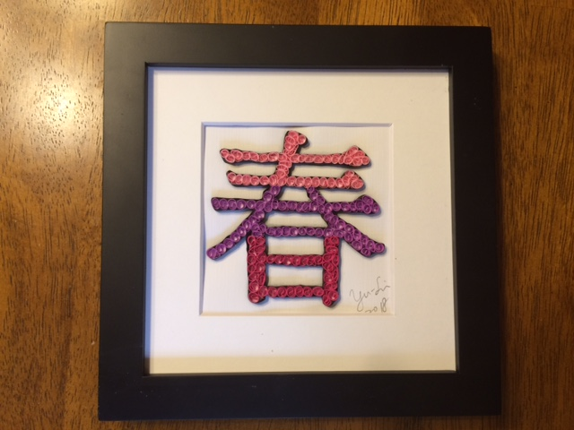

Slide 13
Contributor:
Amanda Chen

Slide 14
Value of 春
Starting Minimum Bid Price:
$15 ea
Market Price:
$20 ea

Slide 15
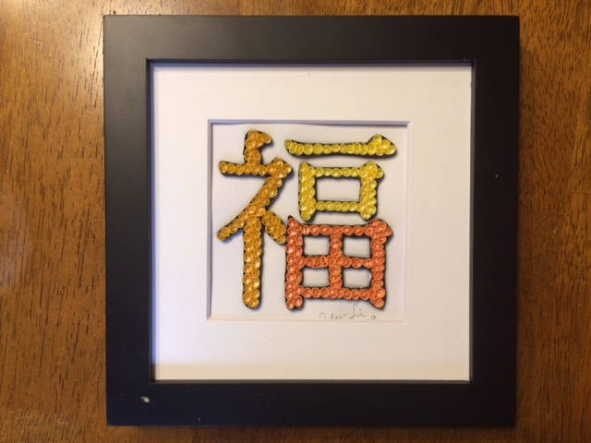

Slide 16
Value of 福
Starting Minimum Bid Price:
$15 ea
Market Price:
$20 ea

Slide 18
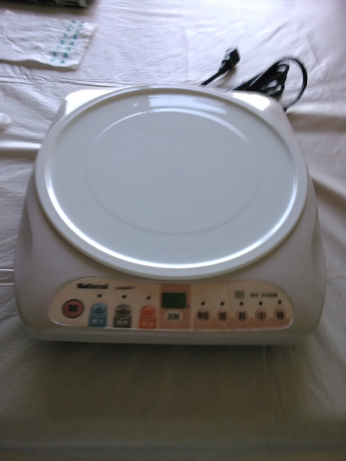
National electric hotpot burner

Slide 19
Contributor:
Teresa Chang

Slide 20
Value of Hotpot
Starting Minimum Bid Price:
$35

Slide 22
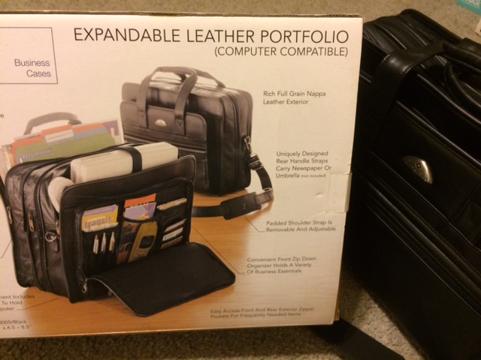
Professonal Leather bag

Slide 23
Contributor:
Ah-Len Huang

Slide 24
Value of Hotpot
Starting Minimum Bid Price:
$35

Slide 25
Thank you
very much
for your
participation

