Slide 1
FAPA-NJ Chapter Open House Meeting
July 15, 2018
Auction

Slide 2
Auction A & B
One week Deluxe Vacation
at
Grand Mayan Riviera Maya Resort
Cancun, Mexico

Slide 3
One Whole Week
Starts from
Friday, Saturday or Sunday
Between August 1st, 2018
to December 22, 2018

Slide 4
Item A
Master Room
King size bed
Sofa (bed)
Jacuzzi
Shower Bath
Accommodate :
2 adults & 2 children

Slide 5
Item B
One Bedroom Suite with
Living Room & Kitchen
King size bed
Two Sofa (bed)
Jacuzzi tub
Shower bath
Plunge pool
Accommodate :
4 adults & 2 children

Slide 6
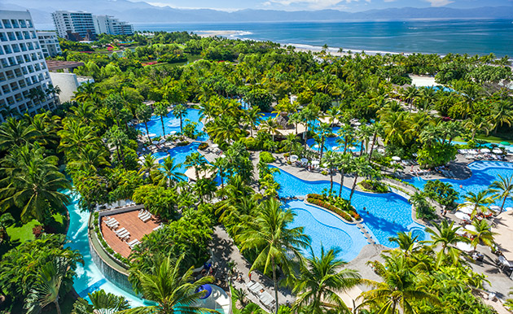
View

Slide 7

Walk Path

Slide 8
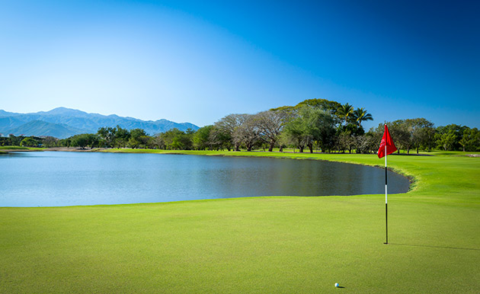
Golf

Slide 9
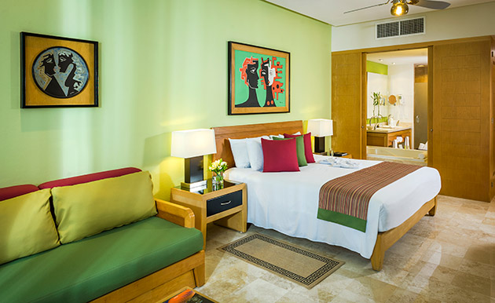
Master Room

Slide 10
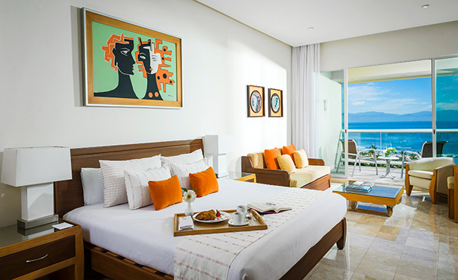
Bedroom

Slide 11
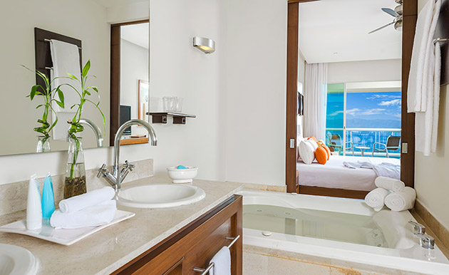
Jacuzzi

Slide 12
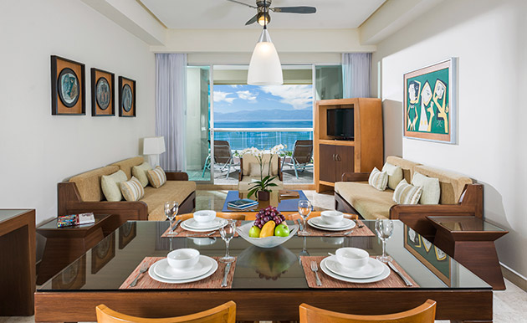
Living Room

Slide 13
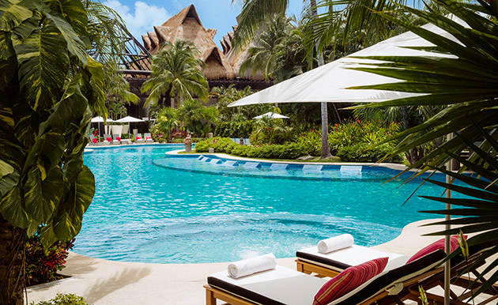
Pool

Slide 14
More info
Mayan Palace official website http://www.vidavacations.com
Nearby attractions : Cozumel, Tulum, Xel-Ha, Xcaret, Chichen Itza, and ….

Slide 15
Combination Bid
Item A & B Combined
One Master Room
One Bedroom Suite
Living Room and Kitchen
Accommodate 6 Adults and 2 Children
Bid price starts at $1,000

Slide 16
Starting Minimum Bid Price:
Item A:
$450 Master Room
Item B
$700 One Bedroom Suite with Living Room and Kitchen

